Slide 1
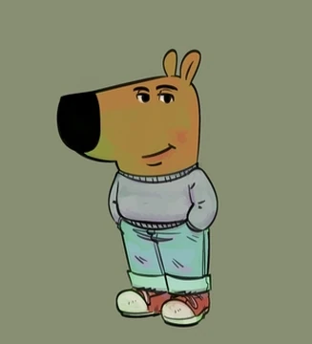
Chill Guy
Where it is from?
The Chill Guy meme, created by artist Phillip Banks, debuted on October 4, 2023, via a post on X, Banks captioned it, “My new character. His whole deal is he’s a chill guy that lowkey doesn’t give a f*ck.” It gained traction but exploded in August 2024 when a TikTok user paired it with other memes, sparking viral spread.
Why its popular?
Chill Guy’s laid-back vibe resonates with internet users craving calm in a chaotic world. Its versatility allows it to fit countless scenarios, from workplace stress to relationship humor, amplified by brands like Sprite and NFL, and even a $CHILLGUY meme coin hitting a $580M market cap. Social media platforms like TikTok and Instagram fueled its spread with remixes, fan art, and cosplay, cementing its cultural status.
TL;DR:
Chill Guy is a cultural icon, blending humor, relatability, and a zen-like defiance of stress.

Slide 2
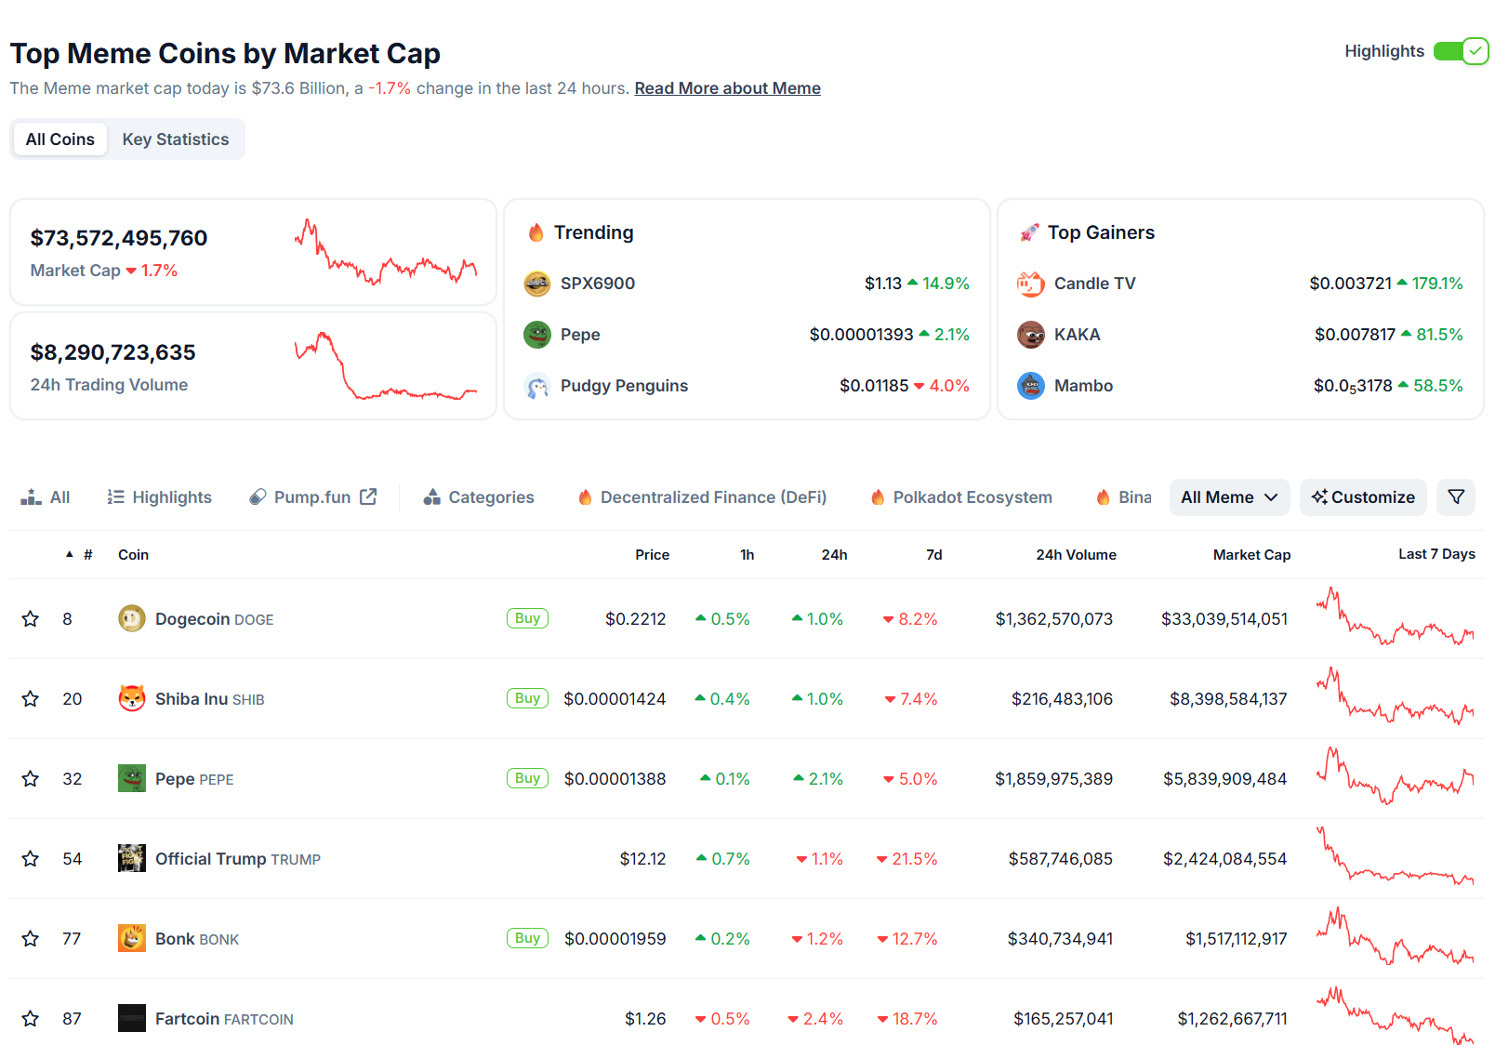
Meme Coin
How Meme Culture Spawned Meme Coins
Meme culture is the internet's lifeblood—those viral, hilarious, sometimes absurd images, videos, or phrases that spread like wildfire across X, Reddit, TikTok, and 4chan. It's all about shared vibes, humor, and community. Memes aren't just jokes; they're a cultural code that unites people around a moment, whether it's a Shiba Inu dog, a sad frog, or a random squirrel. This energy—fueled by FOMO, irony, and the need to be "in on it"—set the stage for meme coins. Here's how it went down:
Memes = Social Glue: Memes thrive on community engagement. They’re not just funny; they create a sense of belonging. In 2013, Dogecoin (DOGE) was born as a joke by Billy Markus and Jackson Palmer, riffing on the "Doge" meme with that iconic Shiba Inu. It was meant to mock crypto's seriousness, but the internet fell in love. The Dogecoin community on Reddit and Twitter (now X) started tipping each other DOGE for dank memes, building a cult-like following. This showed memes could drive action, not just laughs.
Viral Hype = Rocket Fuel: Memes spread fast, and so does hype. When a meme goes viral, it’s like a digital virus—everyone wants in. Dogecoin’s price stayed low for years, but in 2021, it exploded when Elon Musk, the ultimate meme lord, started tweeting about it, calling himself the "Dogefather." His posts, like "Dogecoin is the people's crypto," sent DOGE to a $88 billion market cap at its peak. The internet’s obsession with memes meant one tweet could spark a frenzy, proving meme culture could move markets.
Low Barrier, High Vibes: Memes are accessible—anyone with a phone can get the joke. Meme coins took this to heart. Unlike Bitcoin, which feels like digital gold for tech bros, meme coins like DOGE or Shiba Inu (SHIB) cost fractions of a cent, so anyone could jump in with $10 and feel like a crypto king. Plus, creating a meme coin is stupid easy—platforms like Pump.fun or Solana Token Creator let you mint a token in minutes, no coding needed. This democratized crypto, turning meme cultur

